Slide 1







Cornell Tech & Samsung
Team BlueMoon
Jiacheng Dong
ORIE
James Chen
ORIE
Christian Rodriguez
CS
Mansi Garg
MBA
Harry Li
ORIE
Frans Fourie
ECE
Alan Abraham
MBA

Slide 2
How might we improve the cooking experience?
Notes:
Alan - Add content
Talk about pivoting, and what we learnt from this experience, how we tried our best to keep our spirits up!
Then about the benefits of cooking at home -- according to Harvard Health - The more you cook, the healthier you live.

Slide 3

Meet Samantha
Pain Points
I want combined recommendations for me and my son Jackson, who's allergic to peanuts.
I generally plan a week before to budget my groceries
I would like to avoid food wastage but I keep forgetting about items
Female
36 years old
Software Engineer
Lives in New York
Notes:
Fj and Alan - add content

Slide 4



Samsung Fridge Assistant
A recipe recommendation app that suggests recipes based on the ingredients in your fridge, your user profile and preferences.
Notes:
Alan - Add content
Cooking is easier than people think. It can drastically improve your health and is more fun and cheaper than eating out. And no matter your ability, anyone can learn to do it.
We want people to get into the habit of cooking and ask themselves why I haven’t been doing this my entire life??
A smart that peeks inwards and suggests delicious and nutritious recipes based on available items.

Slide 5
Product Features
Supports multiple profiles (Low effort, High Priority)
Meal planning (Medium Effort, Medium priority)
Recipe optimization (High Effort, Low Priority)
Shopping for missing ingredients (Low effort, Low priority)
Priority - 1>2>4>3
Notes:
To customer
Access to what and quantity of everything you have in your fridge
Find recipes matching your fridge content
Help reduce food wastage

Slide 6
Roadmap
Sprint 3
Task | Timeline
 | Crit | Sprint 3 | Final
2nd survey/ Interviews
Website UI
Website Backend
Recommendation System Ingredient availability Allergens Diet preferences Cuisine preferences Previously chosen
Recommendation System & Meal Planning Popularity/ Score Time it takes Nutrition
Recipe Optimization
Shopping List
Backend-Frontend Integration
Notes:
To customer
Access to what and quantity of everything you have in your fridge
Find recipes matching your fridge content
Help reduce food wastage

Slide 7
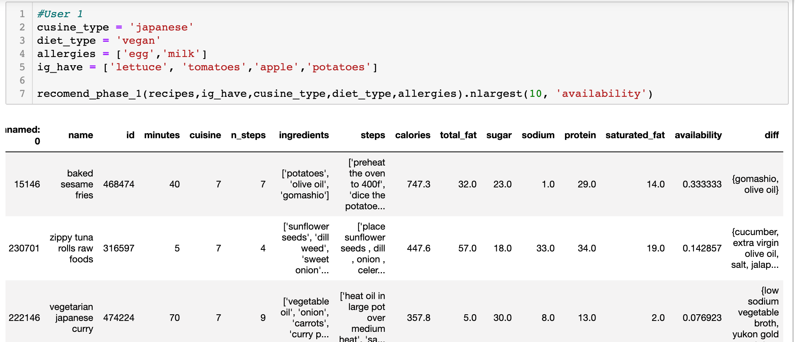
Technical Progress
Notes:
Four diet types: Vegan, Lacto Vegan, Lacto-ovo Vegan, Pescetarian or choose none
10 cuisine and other.

Slide 8
Thank you

